Slide 1

Rossmann Store Sales Forecasting Pipeline
End-to-End Data Engineering, Analytics, Machine Learning, & Deep Learning System
Author: Aishwarya Kumar Singh
Intern – NextHikes IT Solutions
Sunday, February 15, 2026

Slide 2

Introduction
This project implements an end-to-end data processing and analytics pipeline for large Rossmann Pharmaceuticals dataset using Python.
The pipeline reads raw data line by line, performs data cleaning and transformation in memory, and stores optimized outputs in different data formats.
Throughout the execution, detailed logging is maintained to ensure transparency, traceability, and error tracking.

Slide 3

Agenda
Business Problem & Goals
Data Sources & Architecture
Data Engineering Pipeline
EDA & Feature Engineering
Modeling & Comparison
Deployment & Business Impact

Slide 4

Business Context & Primary Goals
Retail stores require accurate daily sales forecasting
Sales influenced by promotions, holidays, customers, and competition
Supports inventory, staffing, and marketing decisions
------------------------------------------------------------------------------
Build a complete ML pipeline from raw data to deployment
Integrate store metadata with transactional data
Analyze customer and promotion behavior
Deliver real-time sales prediction capability

Slide 5

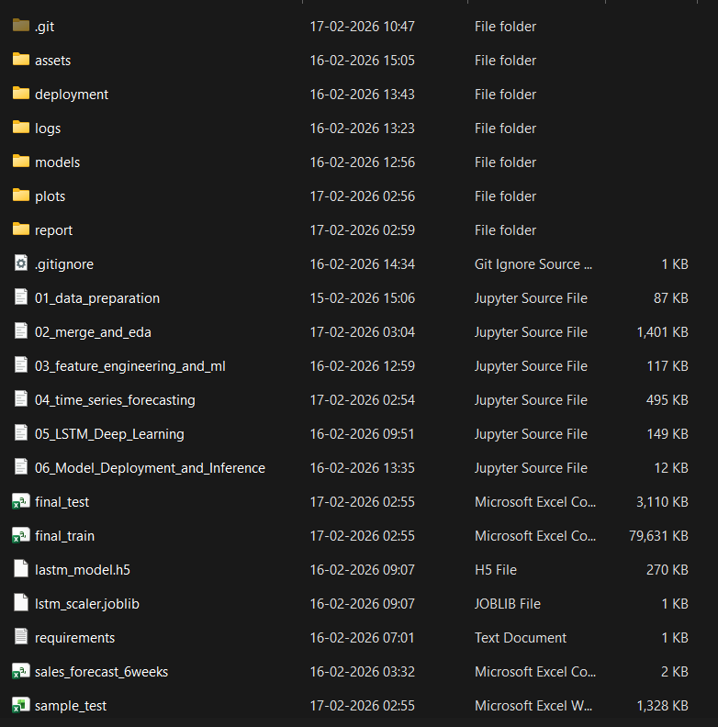
Folder Structure & Analysis Report Screenshots
pharma-trend-forecasting-main/
│
├── assets/
│ ├── images/
│ │ └── store-sale-prediction-nh-project-6.png
│ │
│ └── presentations/
│ └── Rossmann Store Sales Forecasting Pipeline.pptx
│
├── deployment/
│ └── app.py
│
├── .gitignore
├── 01_data_preparation.ipynb
├── 02_merge_and_eda.ipynb
├── 03_feature_engineering_and_ml.ipynb
├── 04_time_series_forecasting.ipynb
├── 05_LSTM_Deep_Learning.ipynb
├── 06_Model_Deployment_and_Inference.ipynb
├── requirements.txt
├── sample_test.xlsx
└── sample_train.xlsx

Slide 6
“ The goal is not to be right. The goal is to make better decisions ”
Cassie Kozyrkov

Slide 7
Data Cleaning and Pre-processing
Standardized column names
Handled missing values systematically
Type coercion for numeric columns
Removed duplicates where applicable
Handled missing values and inconsistent entries
Removed invalid records (closed stores)
Standardized schema and datatypes
Prepared analysis-ready dataset
-------------------------------------------------------------
The data cleaning and pre-processing were critical to ensure the reliability and accuracy of Rossmann Sales data usage analysis.
The raw dataset contained missing values, inconsistent data types, duplicate records, and outliers that could distort analytical insights.

Slide 8

Processing Strategy
There were 6 different notebooks for processing to reach to the prediction modeled data.
01_data_preparation.ipynb
02_merge_and_eda.ipynb
03_feature_engineering_and_ml.ipynb
04_time_series_forecasting.ipynb
05_LSTM_Deep_Learning.ipynb
06_Model_Deployment_and_Inference.ipynb

Slide 9

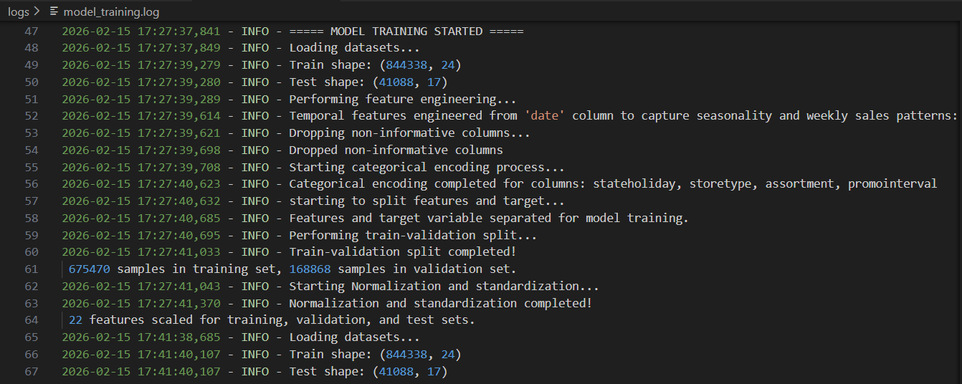
Logging Implementation
Centralized logger configured at pipeline start.
INFO logs for every major step.
Column-level logs for transformations.
Error handling with descriptive messages.
Log file saved under logs/ directory
This is important implementation to track
the activities in the pipeline of the project execution.

Slide 10
DATA Sources
Pipeline Architecture
train.csv – historical transactions
test.csv – unseen prediction dataset
store.csv – store metadata
Over 1 million records across multiple stores
Data ingestion and validation
Merge transactional and store data
Data cleaning and preprocessing
Feature engineering
Machine learning modeling
Deployment for prediction

Slide 11
Exploratory Data Analysis
Sales distribution analysis
Promotion impact evaluation
Holiday vs non-holiday performance
Customer count correlation with sales

Slide 12
Analysis and Graphs
Univariate Analysis
Explored single features’ distributions, central tendency, and spread using histograms, bar plots, and boxplots to detect skewness and outliers.
Excel workbook and its worksheets were created using code, with each sheet uniquely capturing specific analysis results, ensuring automation, transparency, and reproducibility throughout.
To see the graphs and the worksheets, one needs to wait for generation of the images(plots/graphs) and the workbook. Once done, they can be seen in the respective folders and workbook.
Bivariate Analysis
Examined relationships between two variables with scatter plots, correlation heatmaps, and grouped bar charts to identify trends and associations.
Multivariate Analysis/ PCA
Analyzed interactions among multiple features using pair plots, heatmaps, and 3D scatter plots to uncover deeper patterns and dependencies.
Outlier Report (Numeric)
Code calculated outliers using IQR, logged capped values into a new sheet, and styled table for transparent stakeholder reporting.

Slide 13
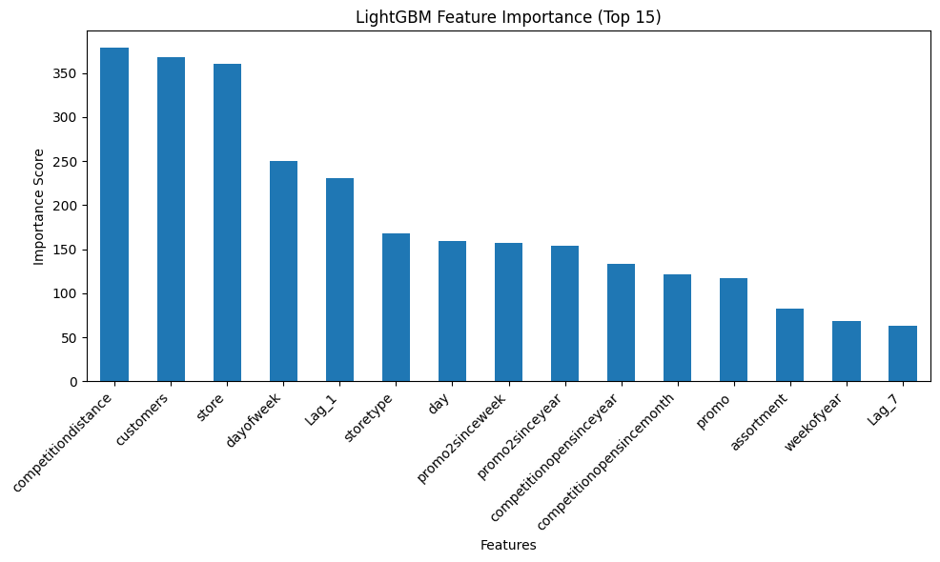
Feature Engineering
Extracted year, month, weekday from date
Encoded categorical store attributes
Prepared structured dataset for modeling
WE do Feature Importance using Random Forest
Performed the Validation set statistics

Slide 14

Machine Learning Models
LightGBM – primary model
Time Series forecasting comparison
LSTM deep learning model
`adam` with `mean_squared_error` is a reasonable default for regression. For probabilistic forecasts or different loss behaviours consider MAE, Huber loss, or custom losses.

Slide 15
Model Comparison
Model Selection Justification
Multiple approaches were explored:
Machine Learning (LightGBM)
Time Series Forecasting
Deep Learning (LSTM)
----------------------------------------------------------------------
Evaluated using RMSE and R² metrics
LightGBM achieved best accuracy and speed
Selected for production deployment
The LightGBM pipeline was selected for deployment because:
better performance on tabular retail data
faster prediction time
requires only current store parameters
suitable for real business users

Slide 16
Deployment Architecture
Preprocessing + model combined into pipeline
Serialized model for reuse
Streamlit web application for UI
Real-time prediction system
Deployment Readiness
The successful prediction confirms:
model serialization works correctly
preprocessing pipeline functions properly
feature schema consistency is maintained
the system is ready for real-time usage

Slide 17
Business Value Delivered
Key Learnings
Consistency between training and inference pipelines
Importance of preprocessing and feature engineering
Real-world ML deployment challenges
Scalable data processing pipeline.
Audit-ready logs for compliance.
Business Impact
Improves inventory planning
Optimizes staffing
Enhances promotion strategy
Supports data-driven retail operations

Slide 18

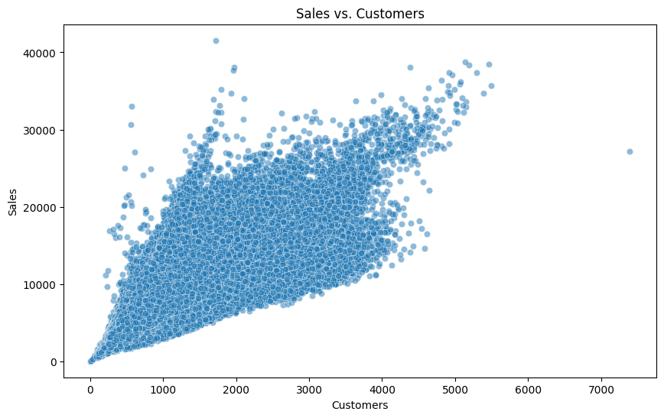
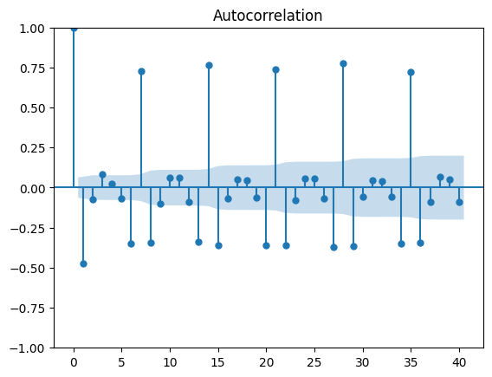
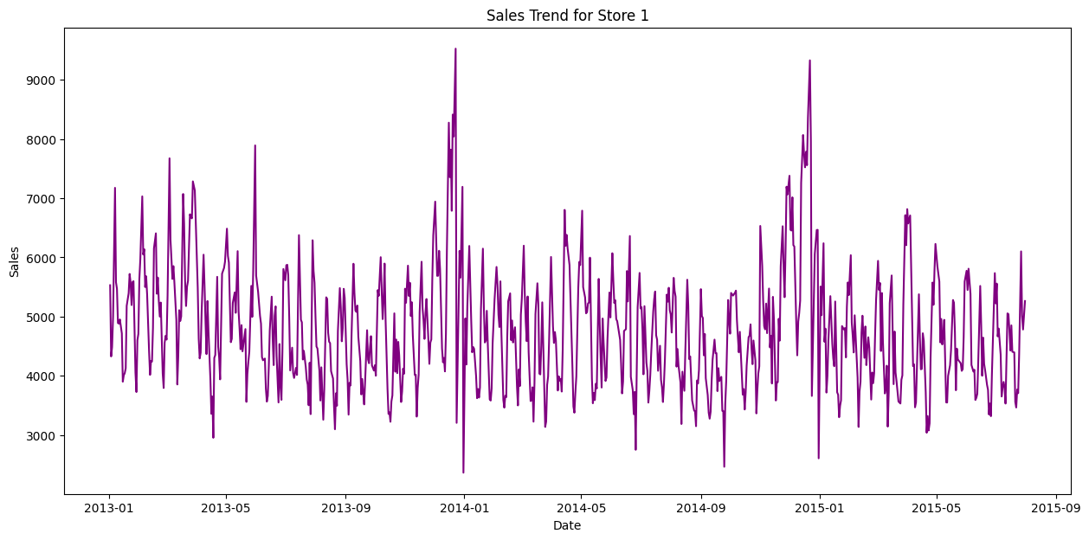
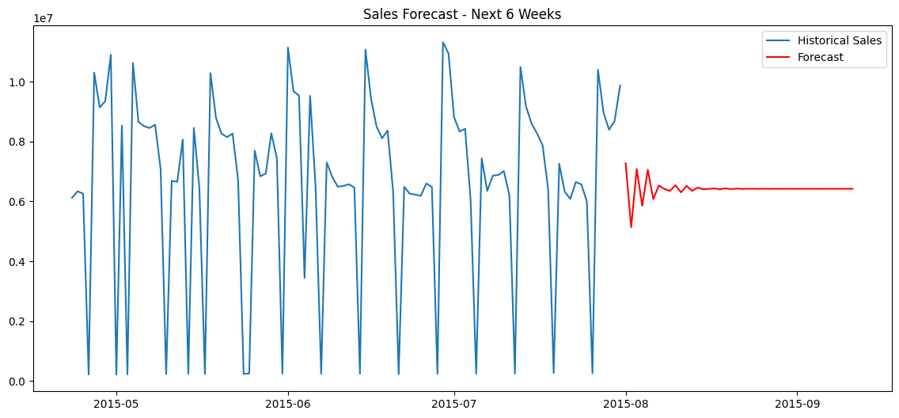
Screenshots

Slide 19
Conclusion
End-to-end ML system successfully implemented.
From raw data to deployed prediction application
Efficient handling of large datasets.
Clear separation of cleaning, storage, and reporting.
Robust logging ensures transparency and maintainability.
Helps stakeholders make informed, data-driven decisions.
Future scope: cloud deployment and dashboards

Slide 20

Thankyou
Aishwarya Kumar Singh
aishsingh702@gmail.com
www.github.com/aishks14

